Slide 1
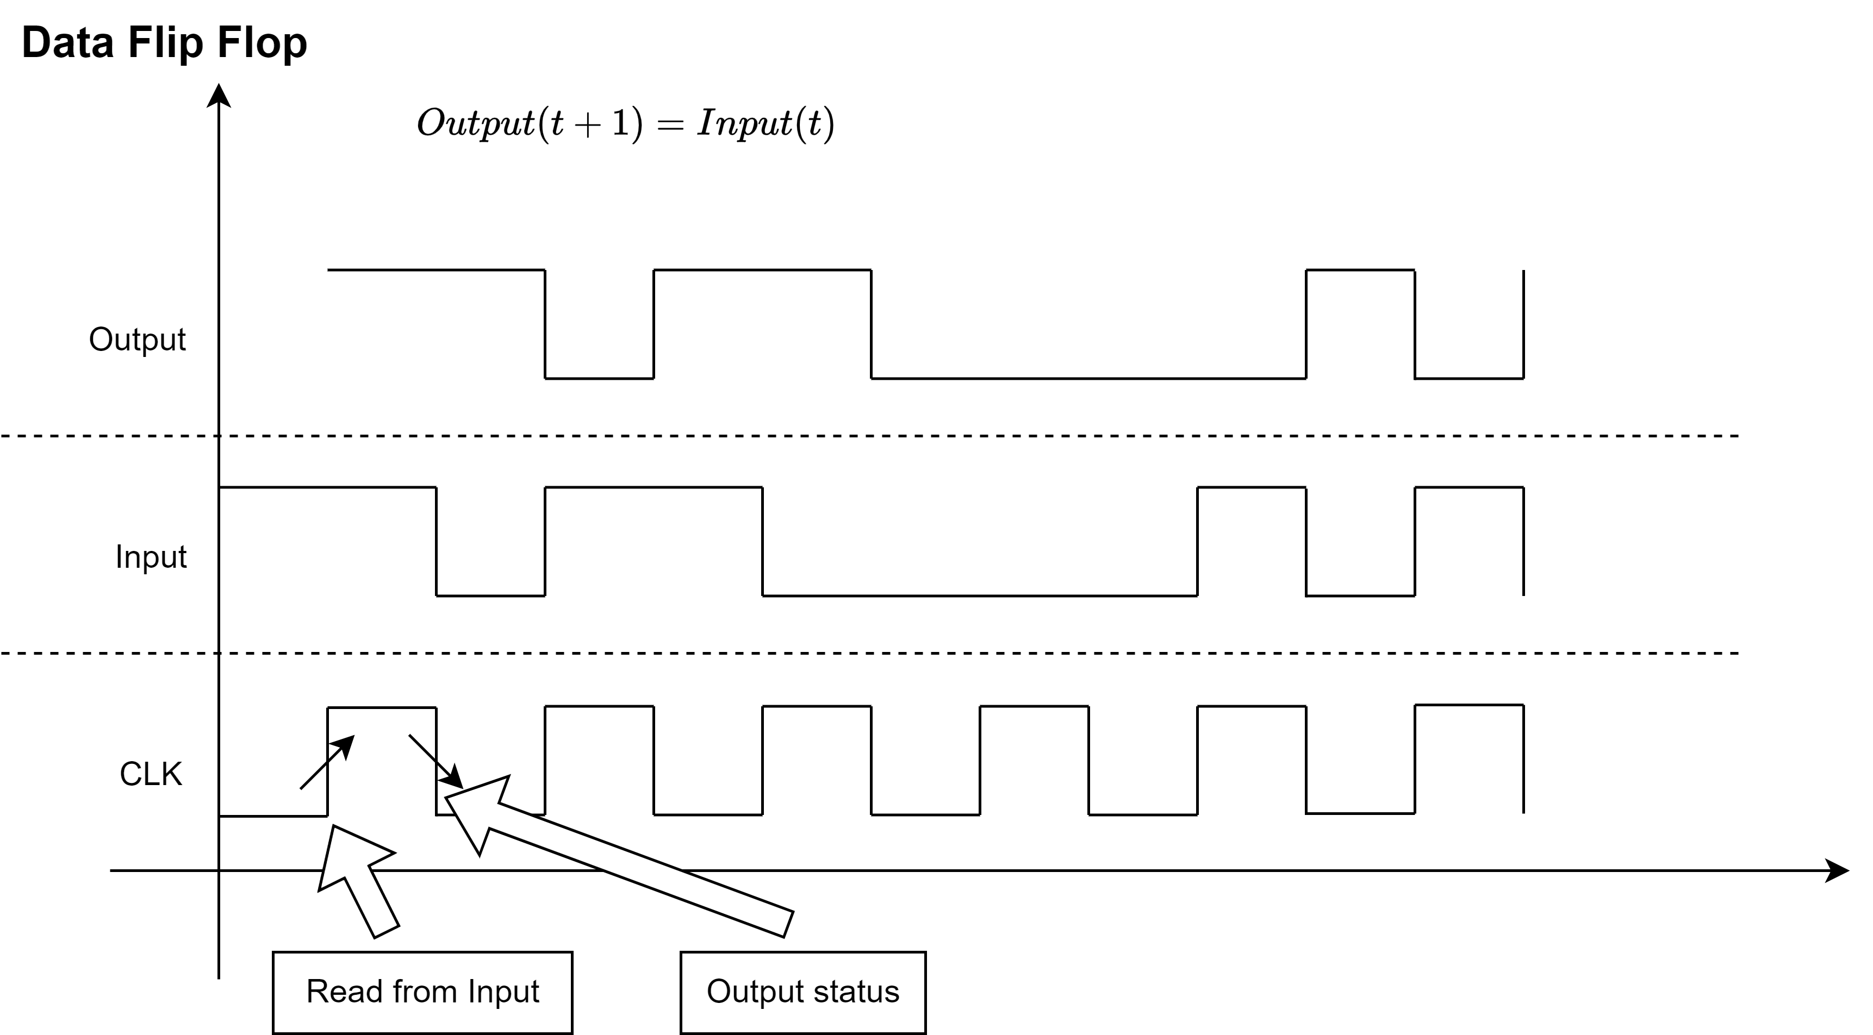

Slide 2
Basic
AND16
Atom Gates
Mux16
NAND
AND, OR, NOT, XOR
OR16
OR8Way
DFF
Mux, DMux
NOT16
input | sel | output1 | output2

